Slide 1
FFPE H&E Manual alignment and registration
Brian
10.18.23

Slide 2
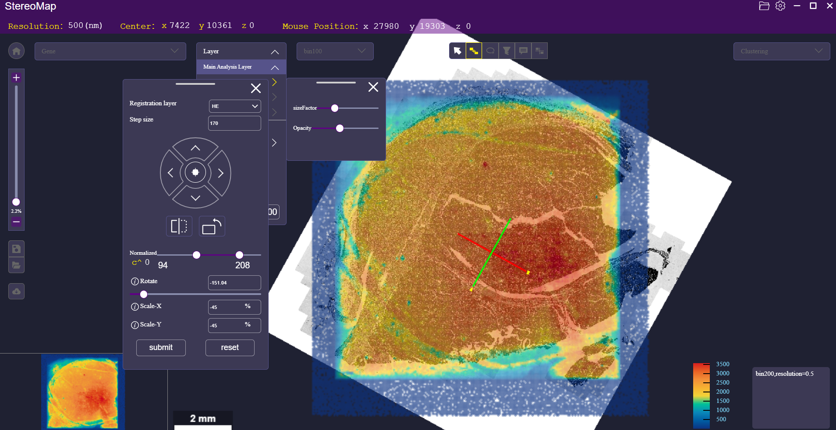
FFPE-2, human kidney cancer: H&E alignment using Stereomap
Opening both <chip_id>.gef HE_fov_stitched.rpi in Stereomap to do manual alignment
After clicking submit, I got a regist.json file which I will be using in the next step

Slide 3
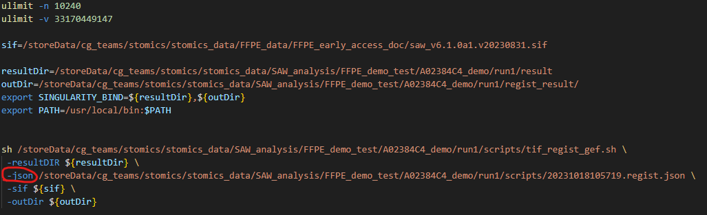
Running H&E registration bash script

Slide 4
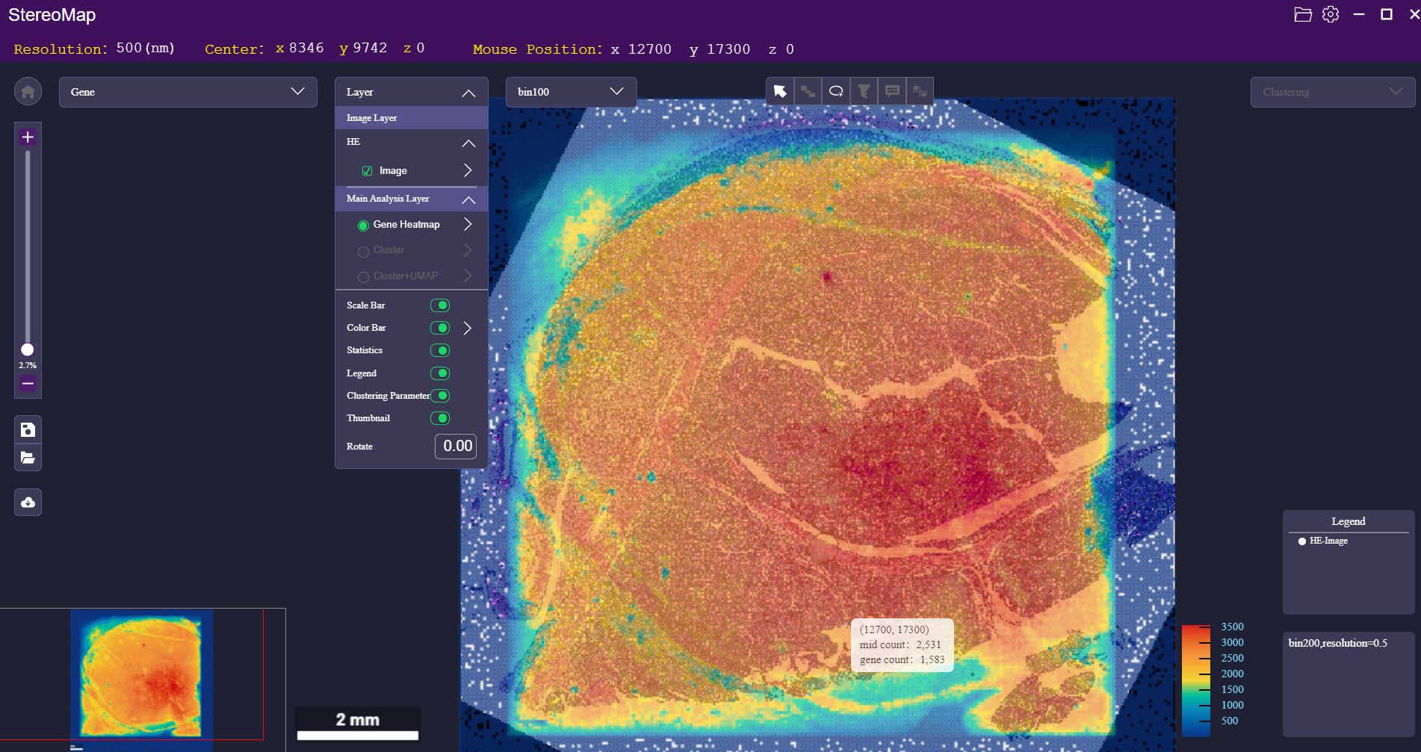
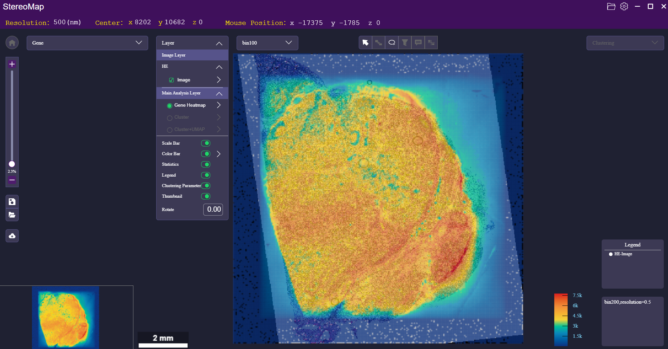
Generating <chipID>.rpi file
This <chipID>.rpi file is the post-registration file that contains H&E layer
Opening <chipID>.rpi file and <chipID>.gef files in Stereomap to view heatmap and H&E layer after HE registration
FFPE-2, human kidney cancer
FFPE-1, human lymphoma

Slide 5
Question
How to create the TIF H&E image that aligns perfectly with the heatmap? (Different tissue sections)

